Slide 1
Business Intelligence: A Visual Application of Data
BI Applications Overview:
Examining the Gartner Report and the Installation of Tableau Reader and Desktop

Slide 2
The Gartner Company - Overview
World's leading information technology research and advisory company
Founded in 1979, Gartner employs more than 1,460 research analysts and consultants, and has clients in 85 countries.
Following information taken from Gartner website:
http://www.gartner.com/technology/home.jsp

Slide 3
The Gartner Report
Gartner defines BI and analytics as a software platform that delivers 17 capabilities across three categories:
Information delivery
Analysis
Integration

Slide 4
The Gartner Report
Information delivery:
Reporting
Dashboards
Ad hoc report/query
Microsoft Office integration
Mobile BI

Slide 5
The Gartner Report
Analysis:
Interactive visualization
Search-based data discovery
Geospatial and location intelligence
Embedded advanced analytics
Online analytical processing (OLAP)

Slide 6
The Gartner Report
Integration
BI infrastructure and administration
Metadata management
Business user data mashup and modeling
Development tools
Embeddable analytics
Collaboration
Support for big data sources

Slide 7
The Gartner Report
Comparison of BI vendors
through the use of a uniform set of evaluation criteria (17 capabilities)
results documented and also displayed graphically (Called the “Magic Quadrants”)
The Magic Quadrants provide a graphical competitive positioning of four types of technology providers, where market growth is high and provider differentiation is distinct

Slide 8
The Gartner Report
Leaders execute well against their current vision and are well positioned for tomorrow.
Visionaries understand where the market is going or have a vision for changing market rules, but do not yet execute well.
Niche Players focus successfully on a small segment, or are unfocused and do not out-innovate or outperform others.
Challengers execute well today or may dominate a large segment, but do not demonstrate an understanding of market direction.

Slide 9
The Gartner Report – Summary
Vendors lack enterprise-wide robustness with respect to governance, administration and scalability
Applications cannot easily be expanded to interactively include all departmental functions
Analytic platforms are still IT-centric and less business-based
Cloud BI becoming more acceptable as a deployment option

Slide 10
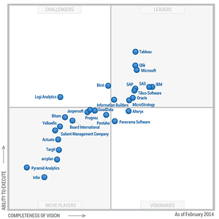
The Gartner Report – Magic Quadrants
Top 4 Players:
Tableau
Qlik
Microsoft
IBM

Slide 11
IBM – Insight (Overview)
Provides desktop users data interactivity, analysis and visualization capabilities
However, wider adoption restricted due to:
Cost of software
Lack of ease of use for business users
Poor performance and support quality

Slide 12
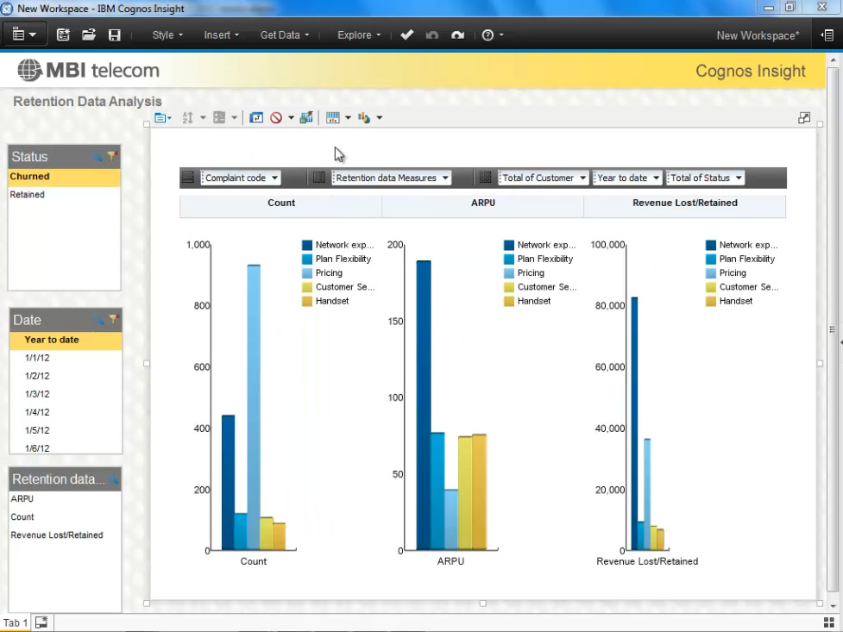
IBM – Insight (Screeshots)
Create dashboards with drag-and-drop features

Slide 13
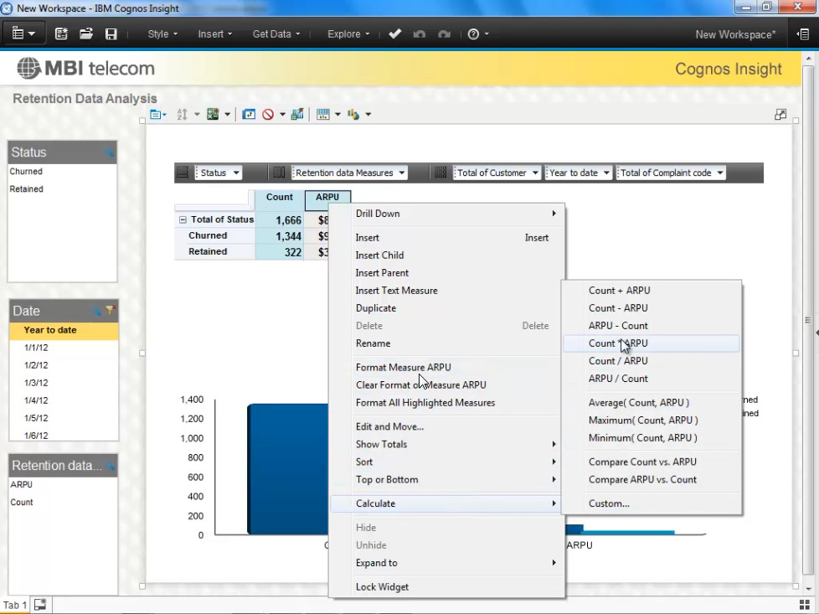
IBM – Insight (Screenshots)
Right-click built-in calculations

Slide 14
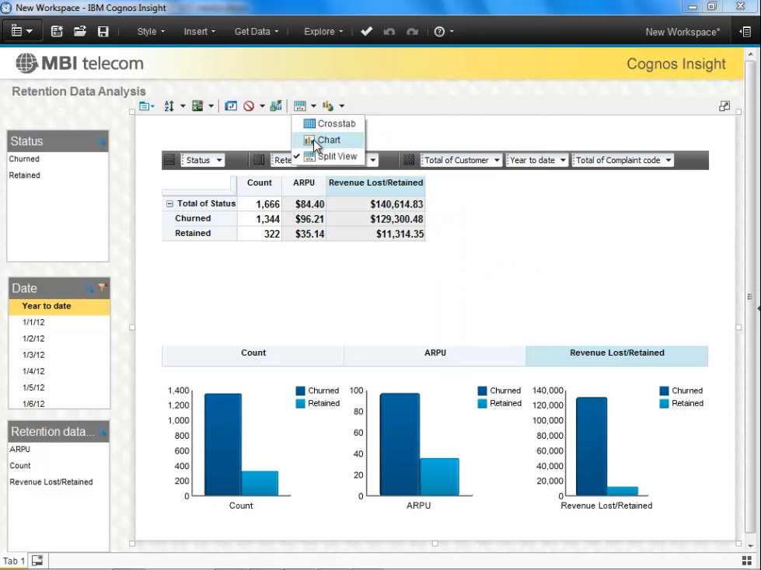
IBM – Insight (Screenshots)
Can write directly into cells, without scripting

Slide 15
IBM - Insight
Below Average Capabilities:
geospatial and location intelligence
interactive visualization
embedded advanced analytics
embeddable analytics

Slide 16
Microsoft – Power Pivot (Overview)
Most progress toward delivering a combination of business user capabilities with an enterprise-capable platform
Provides a personal PowerPivot workbook to an enterprise data source
Lower licensing cost
Bundling BI with its most widely used products

Slide 17
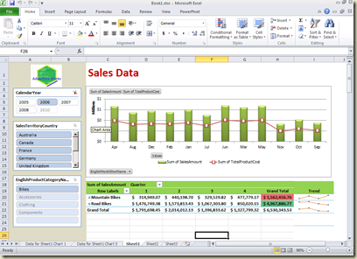
Microsoft – Power Pivot (Screenshots)
Allows for creation of various table types

Slide 18
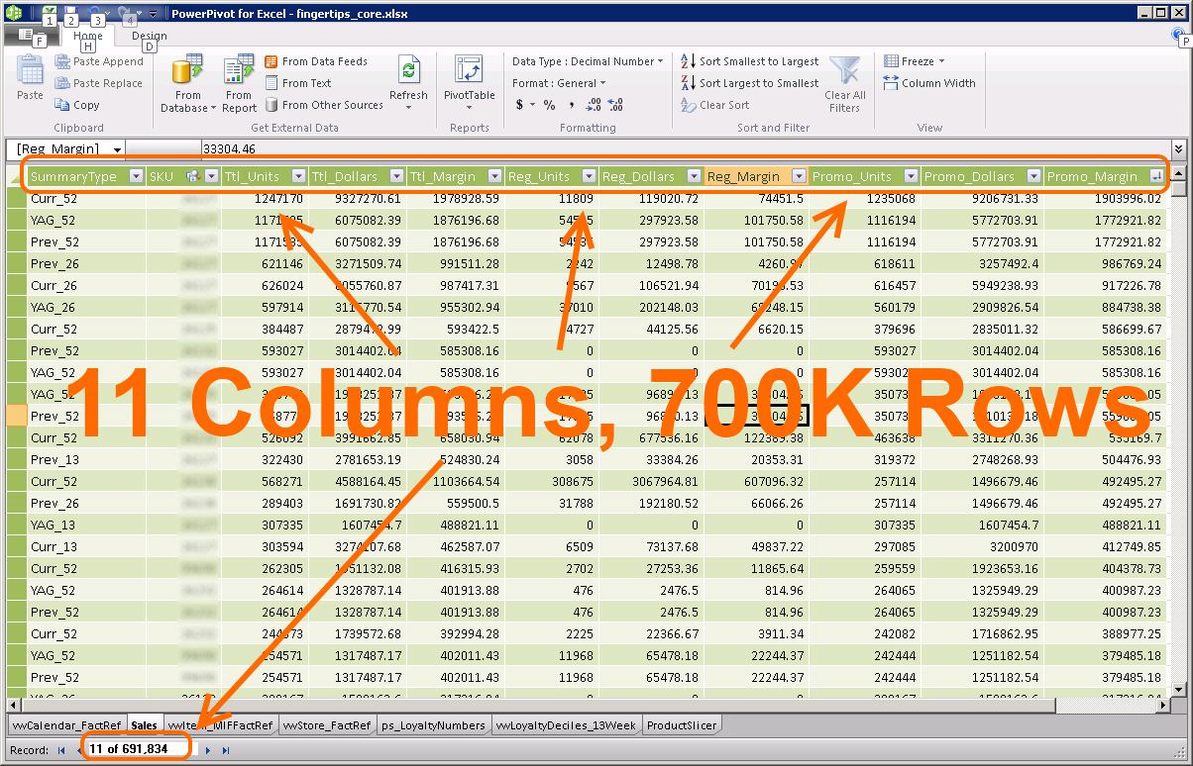
Microsoft – Power Pivot (Screenshots)
Allows for seamless integration with large Excel files

Slide 19
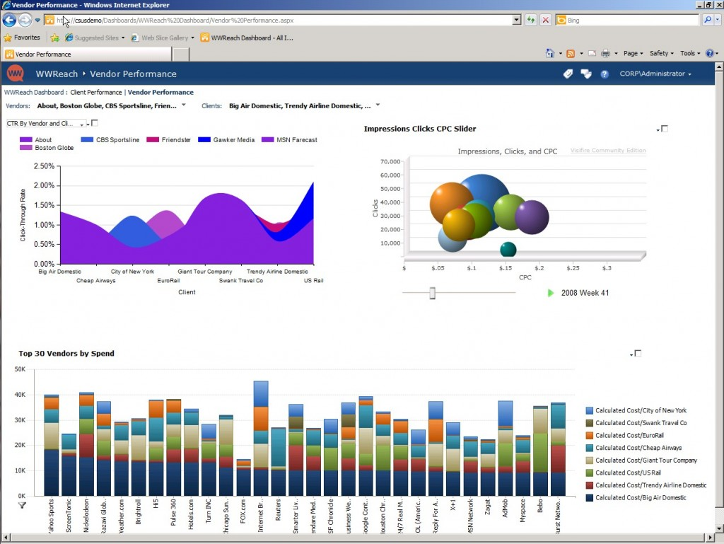
Microsoft – Power Pivot (Screenshots)
Provides for creation of interactive dashboards

Slide 20
Microsoft – Power Pivot
Above Average Capabilities:
BI infrastructure
development tools
Reporting
ad hoc query
Microsoft Office integration
business user data mashup
embedded BI
Collaboration
search BI
OLAP capabilities

Slide 21
Microsoft – Power Pivot
However, wider adoption restricted due to:
Absent or weak functionality
Product weaknesses include:
mobile BI
interactive visualization
metadata management
Lack of support for more complex types of analysis

Slide 22
Qlik – Qlik View (Overview)
Leader in data discovery area
The detection of patterns in data
Provides best BI platform standard in two main areas:
business users' requirements for ease of use
IT's requirements for enterprise features relating to data reusability, governance and control and scalability

Slide 23
Qlik – Qlik View (Overview)
Associative search capabilities:
Displays which query results are related and can compare them
Identify which data elements are not related
No need to write complex SQL
Ease of use for both users and developers

Slide 24
Qlik – Qlik View (Overview)
Has strong functionality
Can undertake complex analysis
Above average capabilities:
dashboards
interactive visualization
search-based data discovery
geospatial intelligence
business user data mashup
Collaboration
big data support
mobile BI

Slide 25
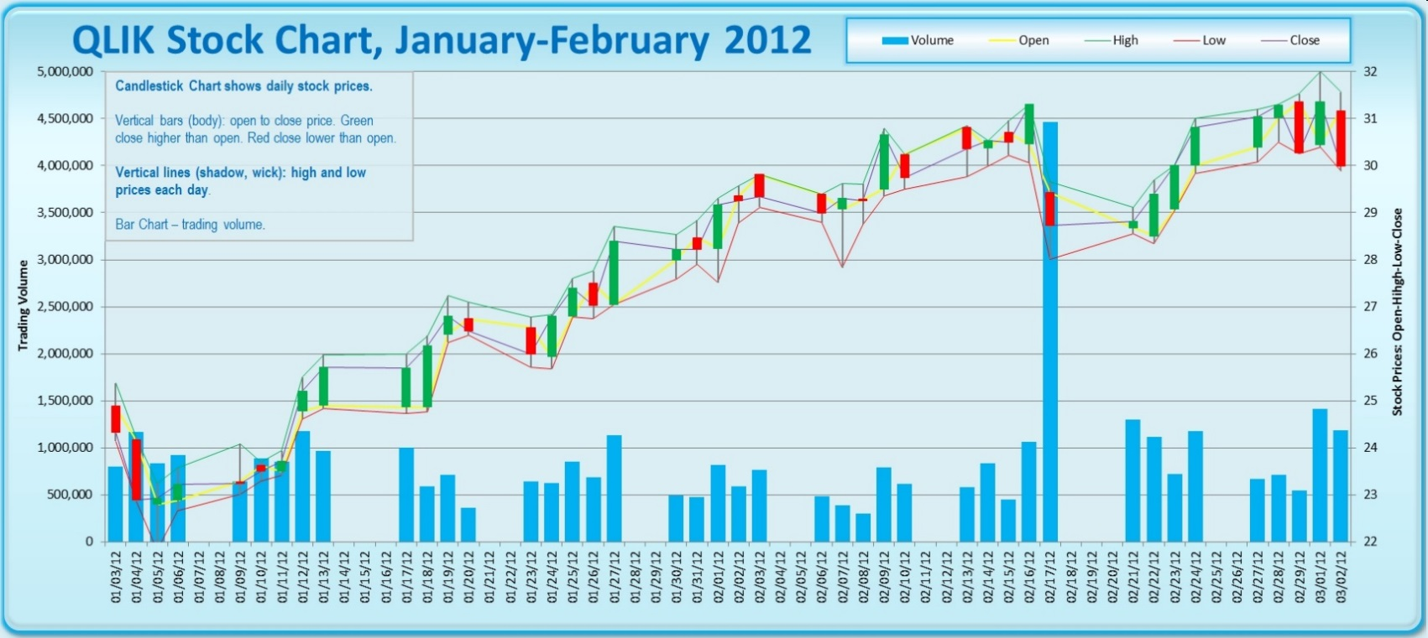
Qlik – Qlik View (Screenshots)
Ability to create multi-layered charts

Slide 26
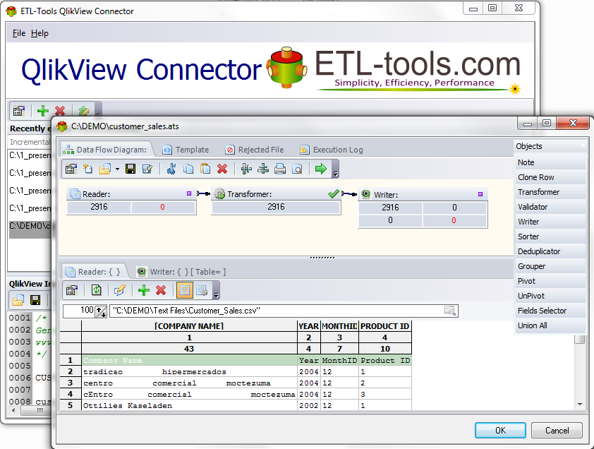
Qlik – Qlik View (Screenshots)
Has various data connectors to perform ETL on data being used in Qlik View

Slide 27
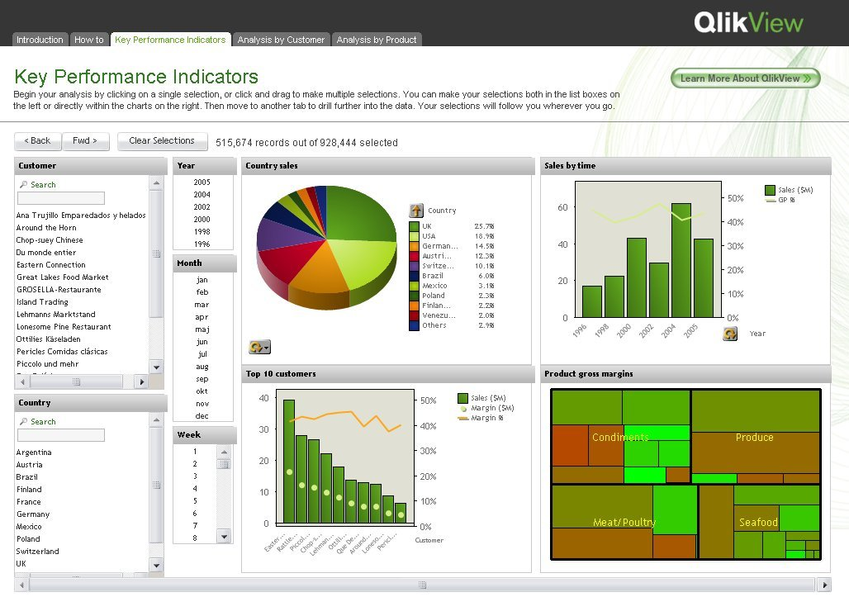
Qlik – Qlik View (Screenshots)
Qlik View can also easily create interactive dashboards

Slide 28
Qlik – Qlik View (Overview)
Below average capabilities:
metadata management
BI infrastructure
embeddable analytics
Relative limited offerings in areas of:
analysis capabilities
user support

Slide 29
Tableau (Overview)
Highly intuitive
Excellent in areas of:
visual-based data discovery
dashboarding
data mashup
Simple and complex analysis easily available to end user

Slide 30
Tableau (Overview)
Provides enterprise requirements for reusability, scalability and embeddability
Easy to use for both end users and developers
Low implementation costs

Slide 31
Tableau (Overview)
Above average capabilities:
reporting
ad hoc query
dashboards
data mashup
geospatial intelligence
mobile BI
interactive visualization
customer support
product quality

Slide 32
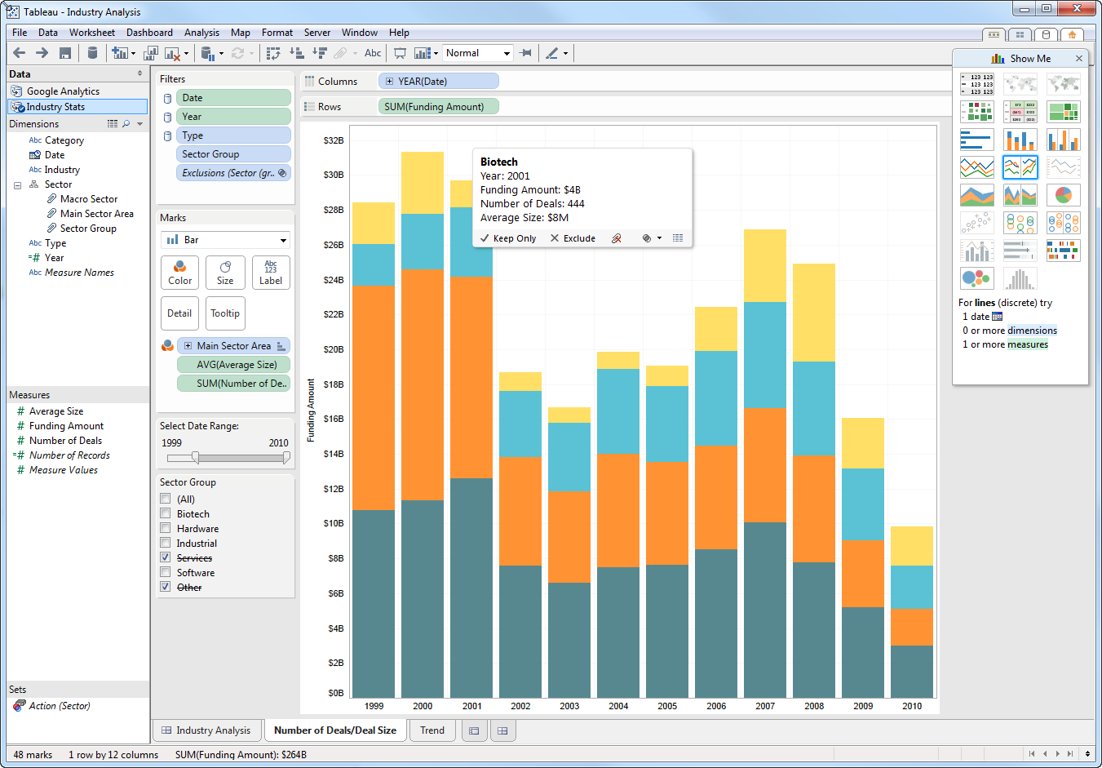
Tableau (Screenshots)
Can create a variety of graph styles and easily change the style of an existing graph

Slide 33
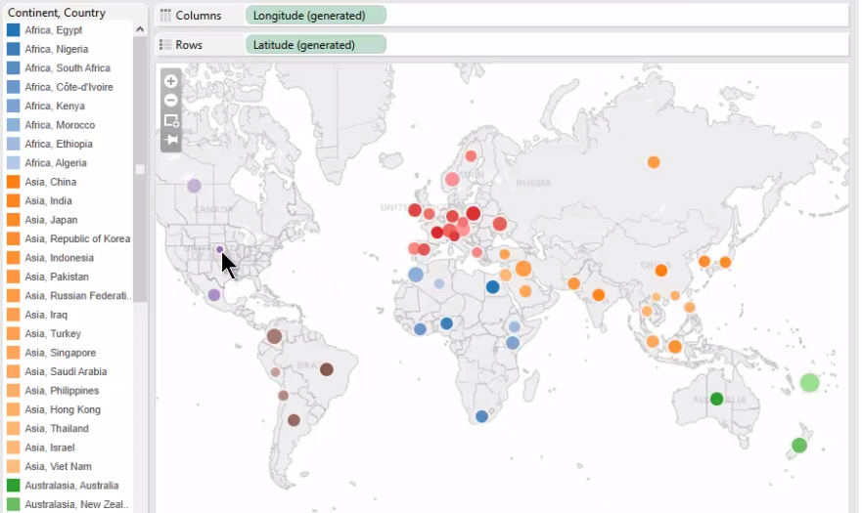
Tableau (Screenshots)
Has excellent geo-coding and mapping capabilities

Slide 34
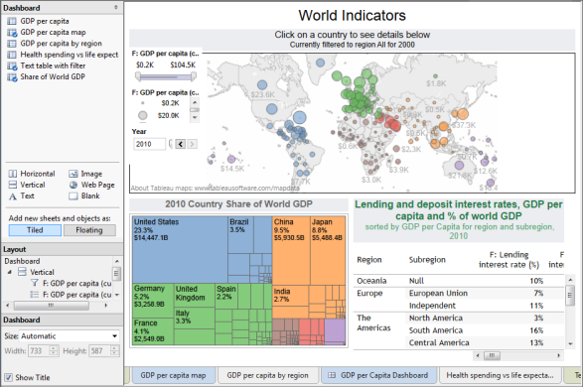
Tableau (Screenshots)
Ability to quickly create dynamic, interactive dashboards

Slide 35
Tableau
Negative aspects:
Often used to complement an existing BI platform (and not be a stand-alone BI platform)
Software costs limit greater adoption
Lacks production reporting
Below average capabilities:
metadata management
BI infrastructure

Slide 36
Tableau
Despite shortcomings, Tableau is the most preferred BI visualization application
End users can easily view data discovery patterns through the use of Tableau Reader
Developers can easily create data visualizations through Tableau Desktop

